Slide 1



GESI and safeguarding Integration by
Nepal Yarn Manufacturer’s Association (NYMA)
Case Studies from Triveni & Jagdamba Spinning Mills

Slide 2
Snapshot: UKaid सीप & NYMA Partnership
With catalytic technical and co-investment support from UKaid सीप, NYMA leads a multi-factory skills development and job creation initiative designed to address skill gaps and workforce demands and upgrade training capacity of the yarn and knit-wear industry.
The four partner industries viz. Reliance Spinning Mills, Triveni Spinning Mills, Jagdamba Spinning Mills and Tricot Industry have trained and placed nearly 2,500 people in various job roles. (Nov 2020)
Key feature: Onboarding more women – by instituting policy for at least 50% trainees to be women – and ensuring empowering, safe workplaces. Other GESI and Safeguarding strategy and techniques:
  Investing in women-friendly infrastructure (separate bathroom, accommodation, lactation space).
  Revising standardized curriculum for apprenticeship-based training encompassing hard and soft skills, including to build confidence and negotiation abilities.
  Instituting necessary safeguards – with special consideration to encourage participation, retention, and a safe working environment for women (e.g. transportation and child-care support, etc.)
  Creating a special safeguard policy to emphasize and orient all team on the value and practices protection against sexual exploitation, abuse, and harassment.

Slide 3
Triveni Spinning Mills

Slide 4
Triveni Spinning Mills
Employment status: Total employed till date – 393 (women – 156 & men - 237).
Improvements made to enroll more women:
Separate hostel & bathroom/changing facilities for women which has resulted in onboarding 156 women into Triveni’s workforce from Dec 2019-Nov 2020. Currently there are 46 women staying in the hostel facilities. The capacity of the hostel is to accommodate 70 at present.
Onboarding of women guards/security personnel & hostel in-charge/caretaker.

Slide 5
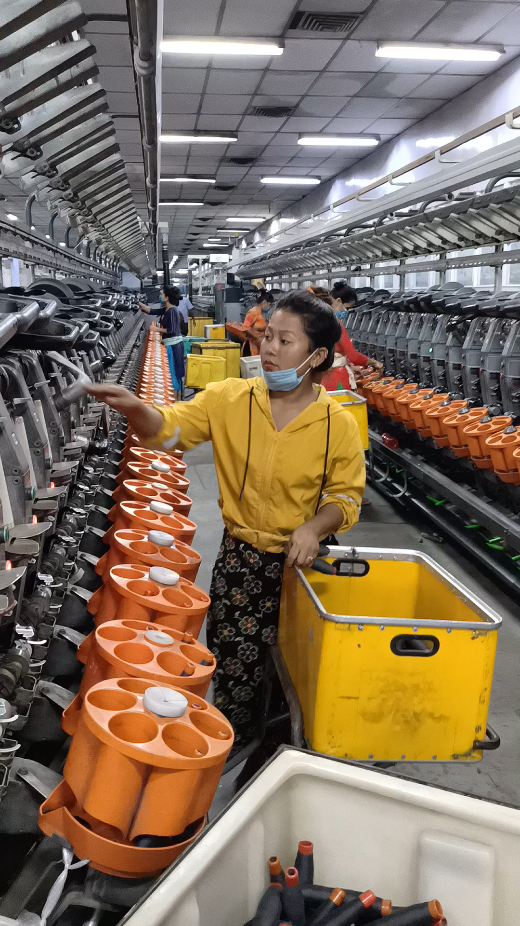
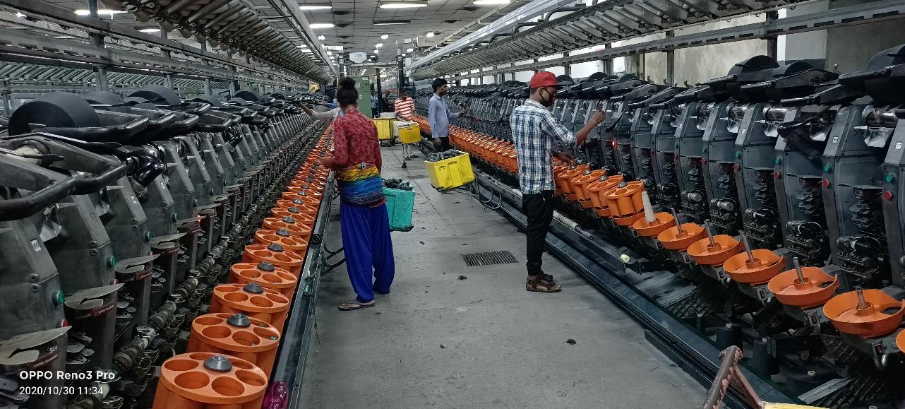
Women at work at Triveni
Click for video

Slide 6
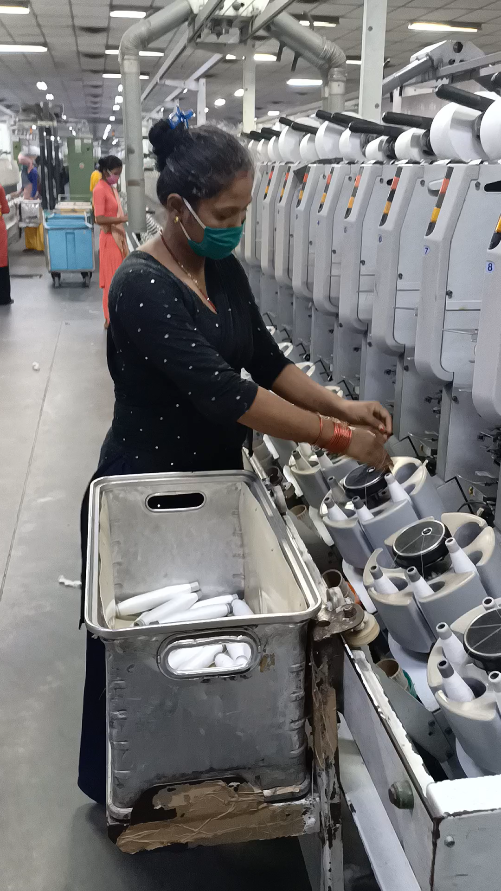
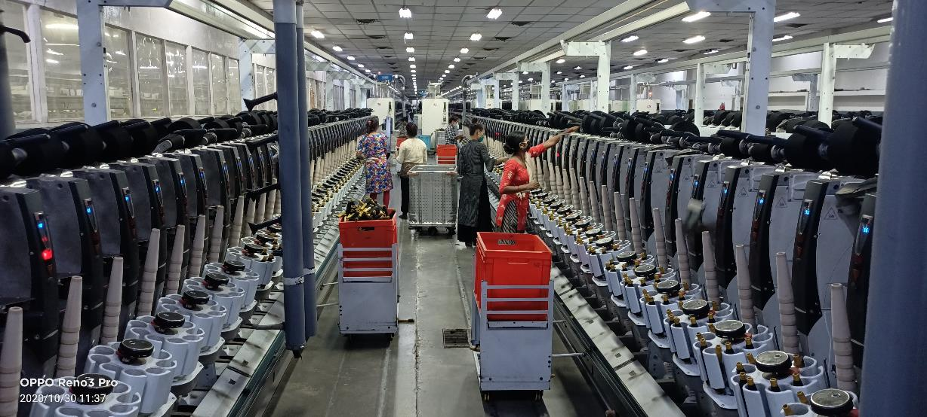
Women at work at Triveni
Click for video

Slide 7
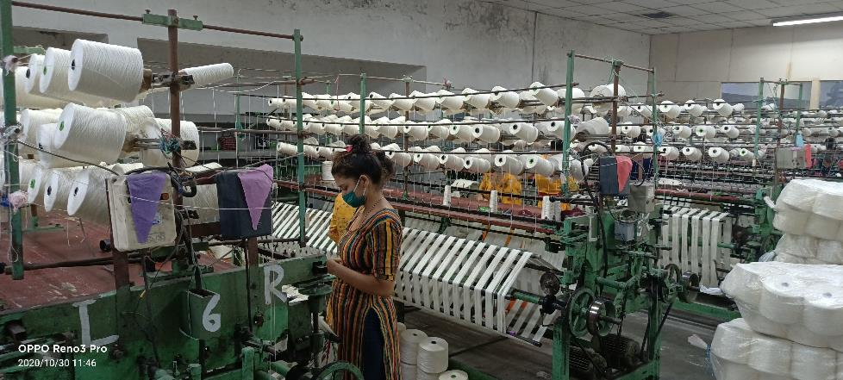
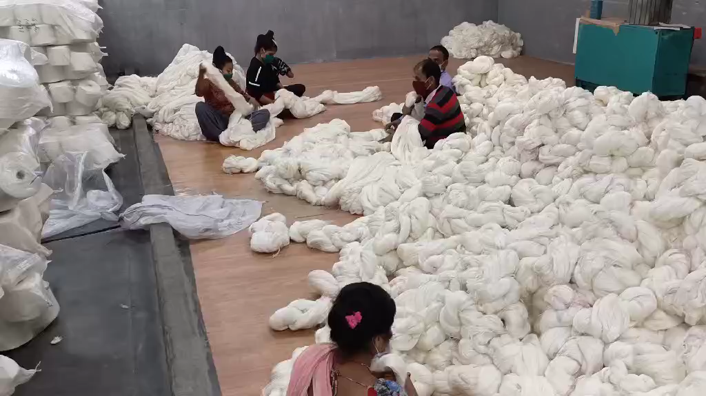
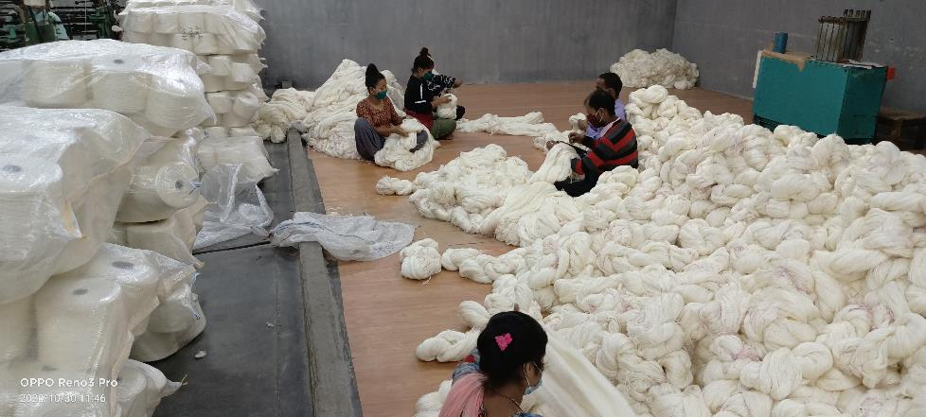
Women at work at Triveni
Click for video

Slide 8
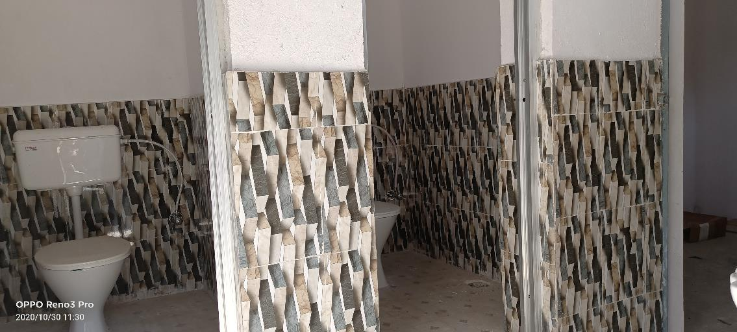
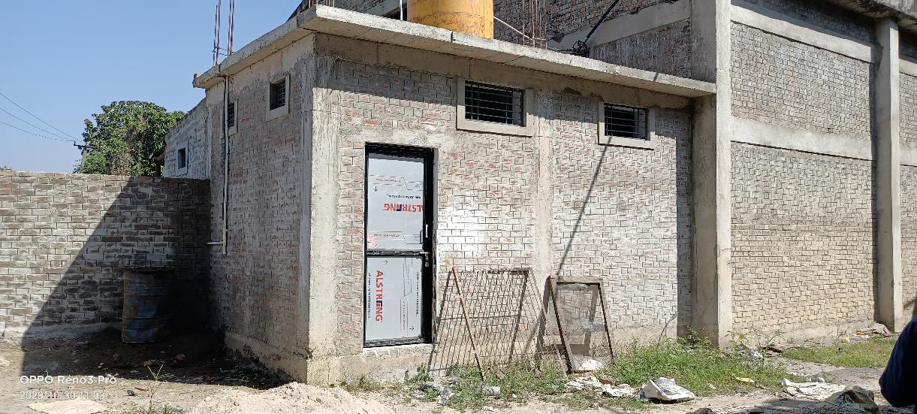
Construction of separate bathroom & changing rooms for women.

Slide 9
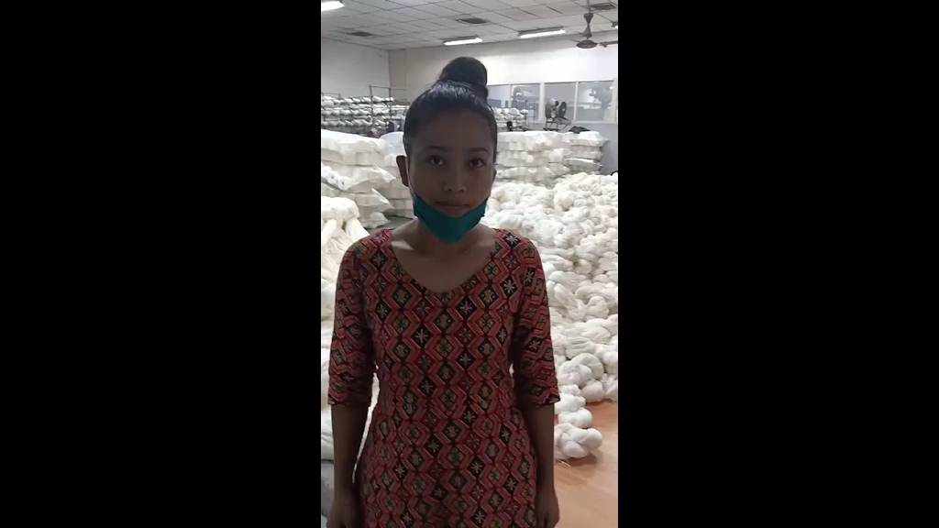
Kriti Lama, 20:
“I have been working in Triveni for about 4 months now and working here has really boosted my self-confidence. I did not have a bank account but now, I get my salary through the bank account set up by the company. These days I feel more confident as I am self sufficient and do not have to depend on anyone else. I am financially independent as I can use my debit card & cheque book to take out money when I need it.”

Slide 10
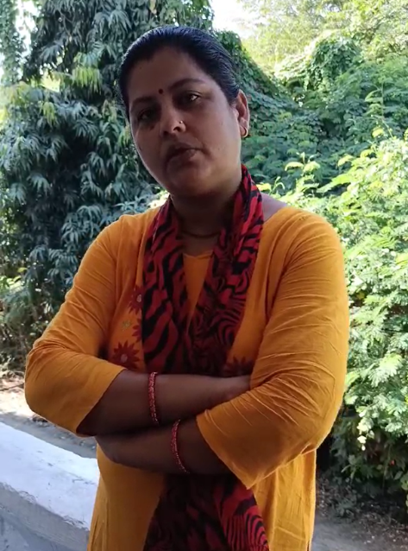
Tara Kumari Paudel, Caretaker at the Women’s Hostel at Triveni shares that the management emphasizes on ensuring safety of all the workers, especially women workers. She gives example of the women security guards that are now part of the factory and provision for medical assistance when/if needed. “The 67 women at the hostel have left there home to come here for a better opportunity and the company has made sure that they are given all the comforts of home. This way, the women are also encouraged to put in all their hardwork. A simple effort, such as hiring of women security guards and free distribution of sanitary pads, has made a great deal of impact in the productivity of the women in the factory.”

Slide 11
Jagdamba Spinning Mills

Slide 12
Jagdamba Spinning Mills
Employment status: Total employed till date – 399 (Dec 2019- Nov 2020)
(50 women on boarded in December 2020 for the first time in the company’s history)
Improvements made and planned to enroll more women:
For convenience and safety of women trainees, Jagdamba is running a bus service (Bhairahawa-Factory-Bhairaha and Lumbini-Factory-Lumbini route).
Plans for a new training hall within its premises is underway.
Jagdamba is also planning to renovate their existing building to provide residential facilities and construct changing rooms, separate washrooms and breastfeeding rooms for women.

Slide 13
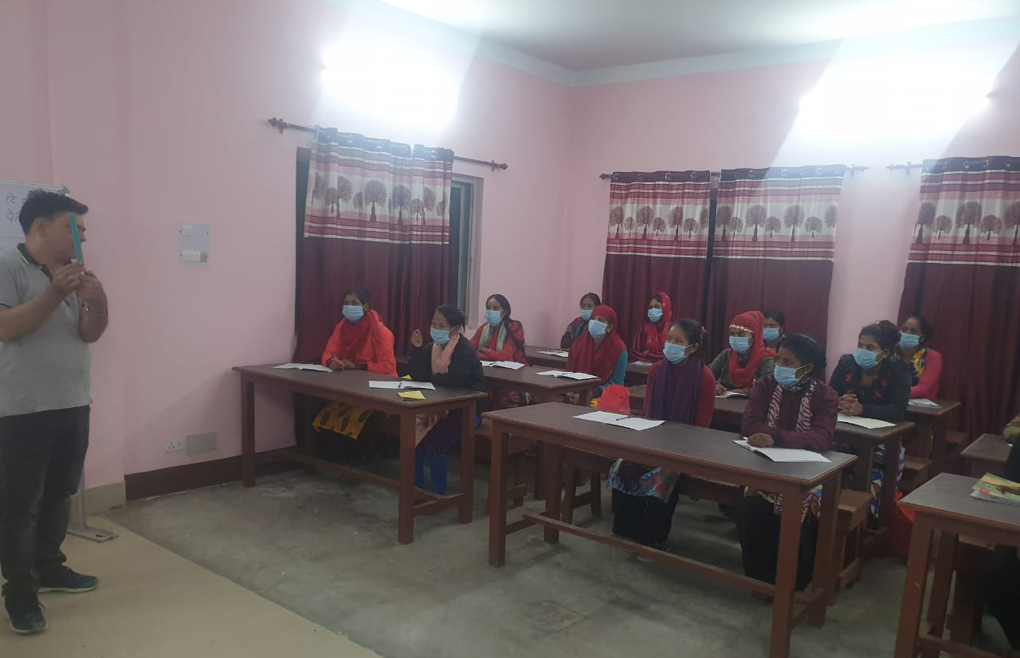
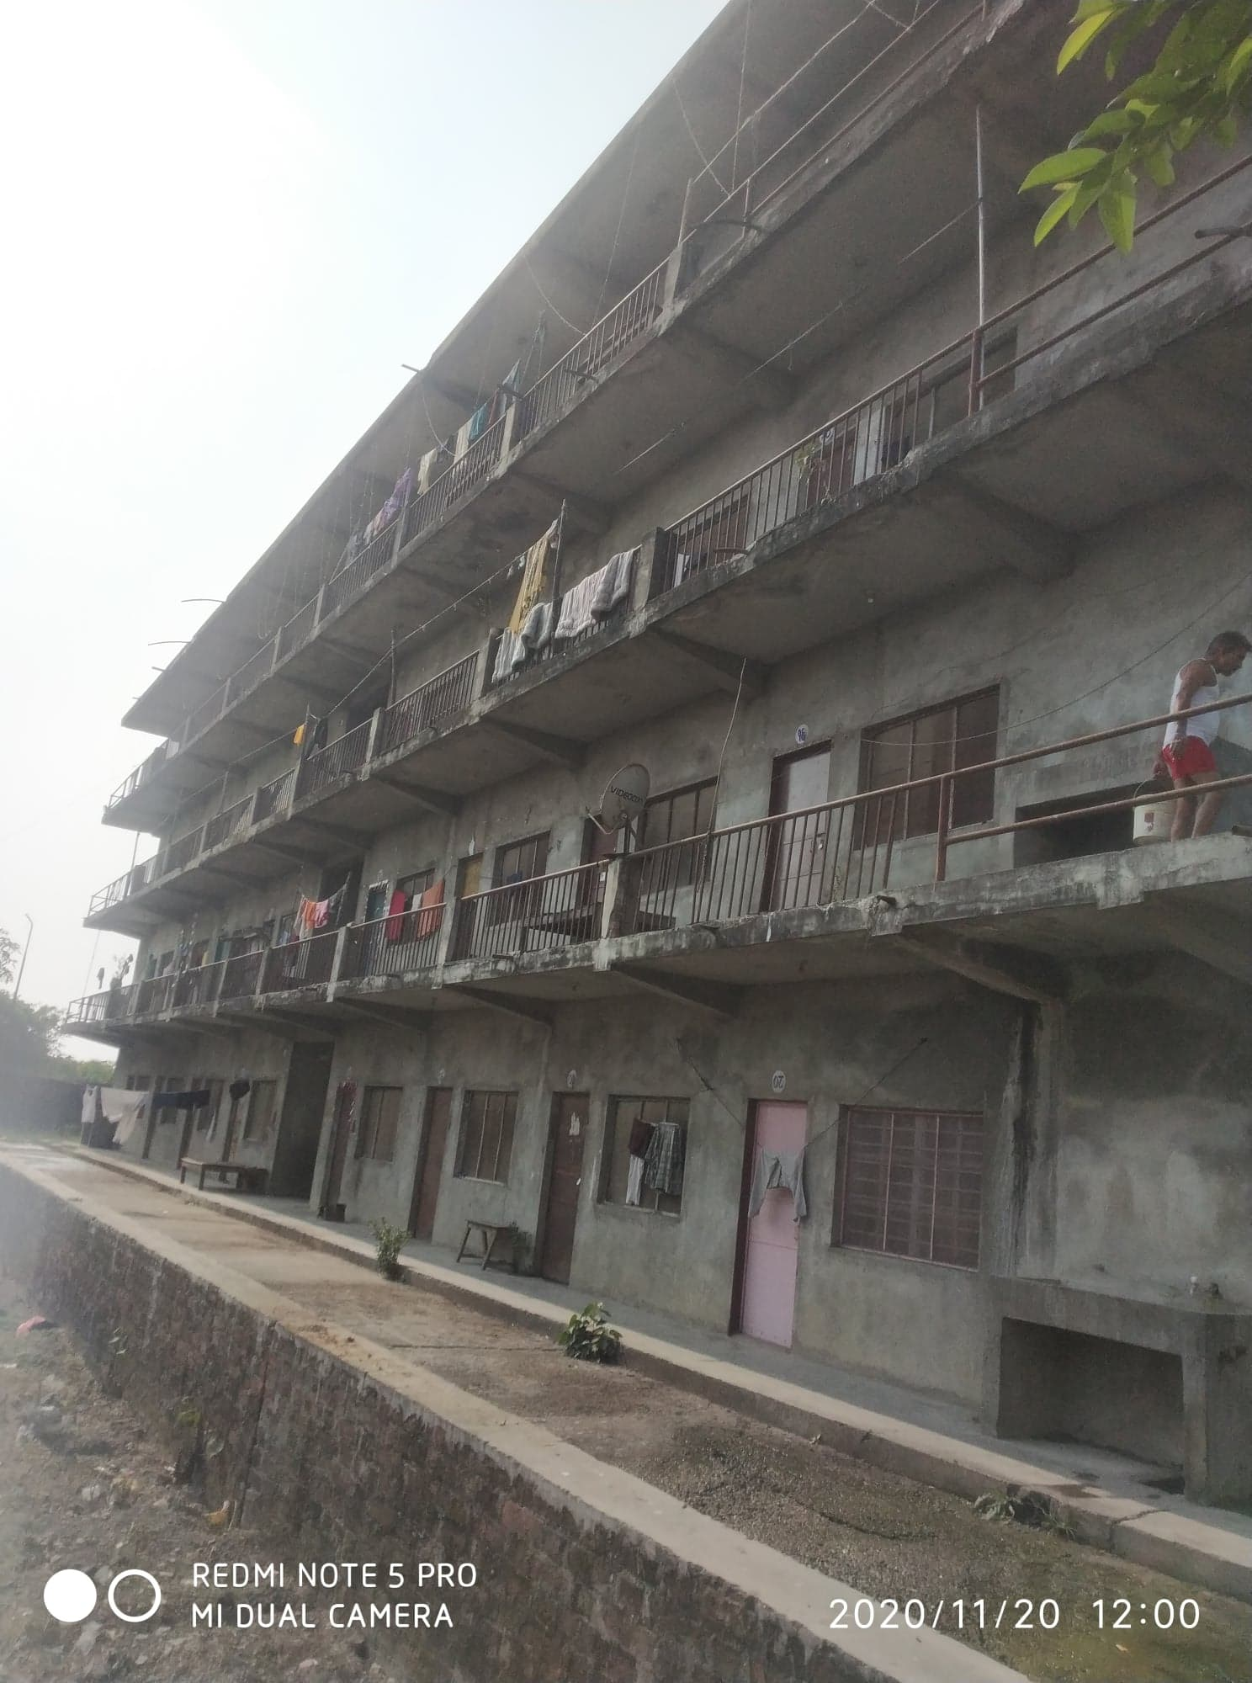
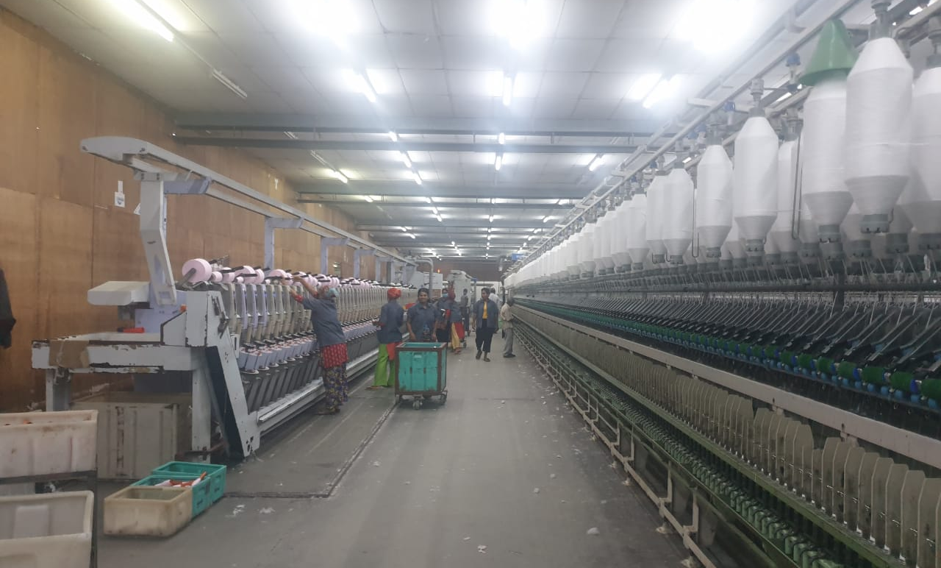
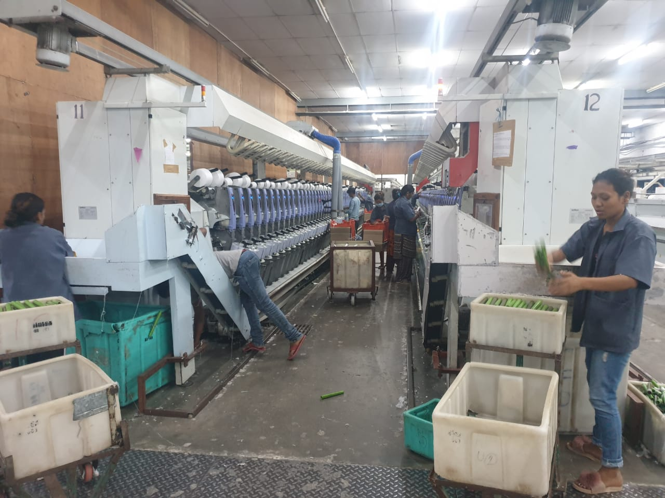
First batch of women trainees at Jagdamba
Building under renovation to accommodate more women.

Slide 14
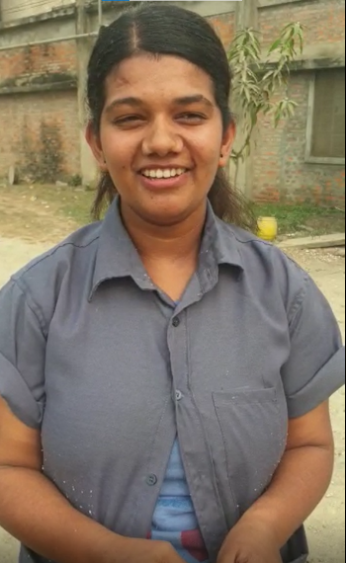
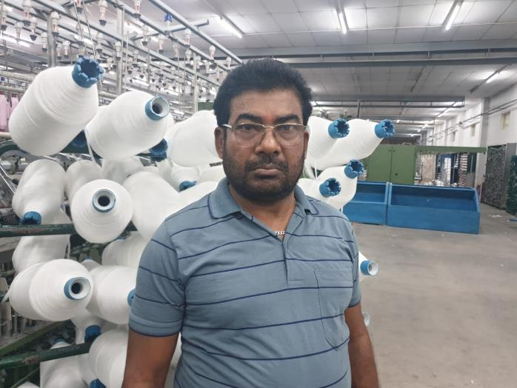
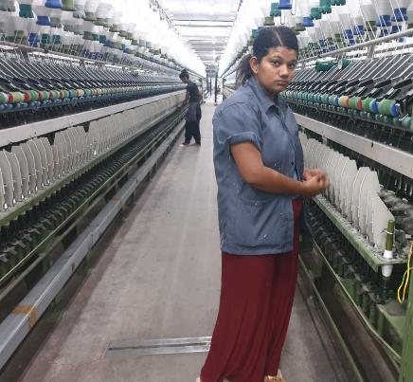
Pavitra Khadka
“I completed my studies as a Lab Technician. Unfortunately, there is lack of employment opportunities in that sector and so I could not find a job. The pressure of shouldering the burden of caring for family without making any use of skills was weighing heavy on me and that’s when I learnt about the placement opportunity at Jagdamba. Needless to say, it was a no brainer for me, and I decided to enroll. I am thankful to Jagdamba for this opportunity, which is also addressing the problem of gender gap in industrial sector. I believe women like me have more available choices for employment for them now.”
“The management at Jagdamba Spinning Mills realized the over representation of men in the factory and the lack flexibility in terms of providing opportunities for women. After various rounds of discussions with NYMA and UKaid सीप, we came up with a plan to enroll more women and provide job opportunities for them. We are certain that this is a win-win situation for both company and for women’s livelihood impact.” - Chandrika Jaiswal, DGM, Jagdamba Spinning Mills

Slide 15
NYMA’s Upcoming SAFEGUARDING plans

Slide 16
Upcoming Safeguarding Plans
Industry-wide roll out of the consolidated Safeguarding Policy followed by training to all employees.
Establish Safeguarding Unit in all partner industries, and as part of which also Safeguarding risk registration process to strengthen the investigation process.
Conduct training on Code of Conduct/Ethics and Behavior.
Ensure a better reporting system across the industries. (Ensuring forms are collected on regular basis on which can then be reflected on the Monthly, Quarterly and Annual Reports on Safeguarding).
Provision of supportive facilities - necessary safeguards – with special consideration to encourage participation, retention, safe work environment for women (transportation, accommodation, and child-care support, etc.)

