Slide 1
UKaid
Skills for Employment Programme (सीप)
Catalyzing Industry-Aligned Gender Equality and Social Inclusion (GESI)
December 2021

Slide 2

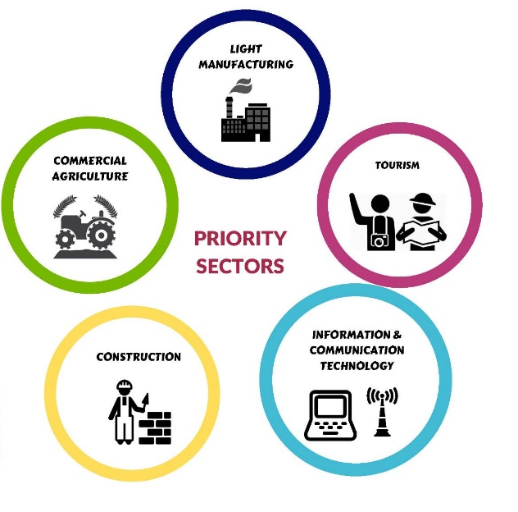
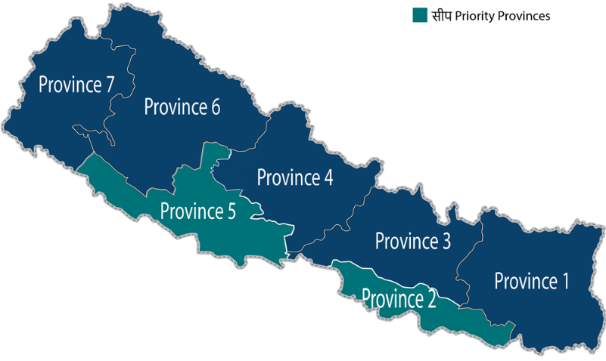

Ukaid सीप Overview
Component 1 – Expanded and Improved Skilling-based Jobs in Nepal
Component 2: Improved Financial Access, Jobs, and Enterprise Development for Migrants/Households
Upskill Migrants
Reduce Cost of Migration/G2Gs
Project Duration: 4 Years
Productive Investments
Reduce Cost of Remittance
Over £9M in Challenge Funding Co-Investments
Alignment with Federal (MoLESS/PMEP and Provincial Skilling & Migration-Related Priorities
Goal: Better train and place Nepalis in both domestic and international jobs
Resulting in 90,000 Nepalis with an increase in income of at least 20% attributed to the project.
  40% will be women
  30% from Disadvantaged Groups (DAGs) including PwDs

Slide 3
Approach: Shifting the Paradigm for Enterprise Growth-based Skilling & Jobs
Continuous Analysis: Emerging Worker Needs & Structural Changes Across Industries
Demand-led Conversations; Understanding Skill Gaps, Firm Growth Needs & Trajectories within Sectors/Firms
Overcoming Market Constraints with Innovative Employer-Led Skilling/Migration Models
Industry & Job Seeker-centric Approach, led by Employers; Co-Investment & Sustainability Approach; Brokering Demand/Supply through Innovations in Job-occupations, Delivery Modality and Technology
Dismantling Social Barriers: Mainstreaming GESI and Safeguarding against SEAH
Strategic Focus on Collaborations to Overcome Firm-level and Systemic Gaps
Whole Ecosystem Vested- Public Private Partnerships; Multi-Sectoral Collaborations; Private Sector Engagement; Replication and Scale up of partnerships by other actors
Integrated, Holistic Approach to Skilling and Placement for Sustained Job Creation and Enterprise Growth (including access to finance - skilling and entrepreneurship loans)
Learning, Knowledge Sharing, and Adaptive Management Prioritized

Slide 4
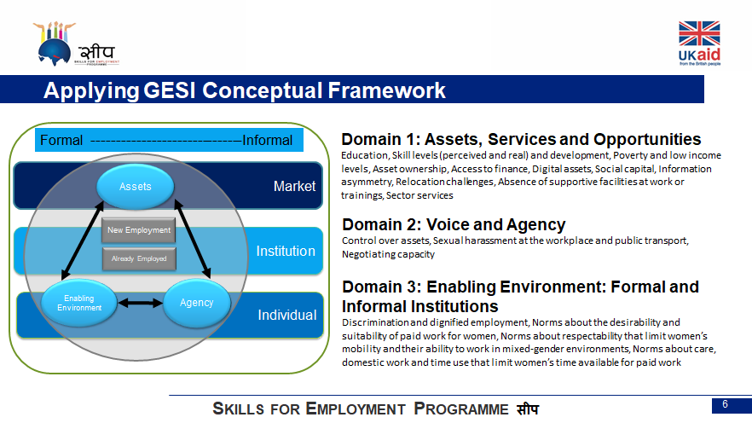
GESI How-Tos: From Research, Partnership Identification, Implementation to Evaluation
GESI Assessment & Intervention Design
GESI Analysis Sectoral Skill & Job Market & Migration
Key Challenge Fund Investment Principle: Inclusion
Rapid GESI assessment Expression of Interest phase
Deep-dive on GESI barriers/gaps Investment Application
Co-create GESI interventions -Dedicated budget, activities, and staff Investment Application & Work Plan
CF GESI Criteria/Questions:
How are you addressing GESI barriers and encouraging participation of GESI target groups to better access market-based livelihood services?
In what capacities are GESI groups included in your application design and plan?
How are you promoting new non-stereotypical job roles for women, and excluded groups?
How will your intervention encourage wider adoption of inclusion-building practices and policies by/within the sector/industry?
Monitoring, Evaluation, Learning (MEL)
Regular GESI Monitoring & Reporting Monthly Reports, Quarterly Reports
Partner Progress Review and Planning Meetings Structured Monthly Meeting
Performance Evaluation Against GESI Targets/Outcome
Knowledge-Sharing - Case Studies, Impact Stories, Social Media, Public Engagements & Events
Adaptive Management Increased & expanded focus on women & PwDs in all scaled-up partnerships
Ongoing Technical Assistance (TA)
Training & Refreshers on GESI Induction Workshop; Special GESI/Safeguarding Sessions
Ongoing, flexible Technical Advisory Though-out Partnership; Peer-to-Peer Learning Session; Monthly Partner Meetings

Slide 5
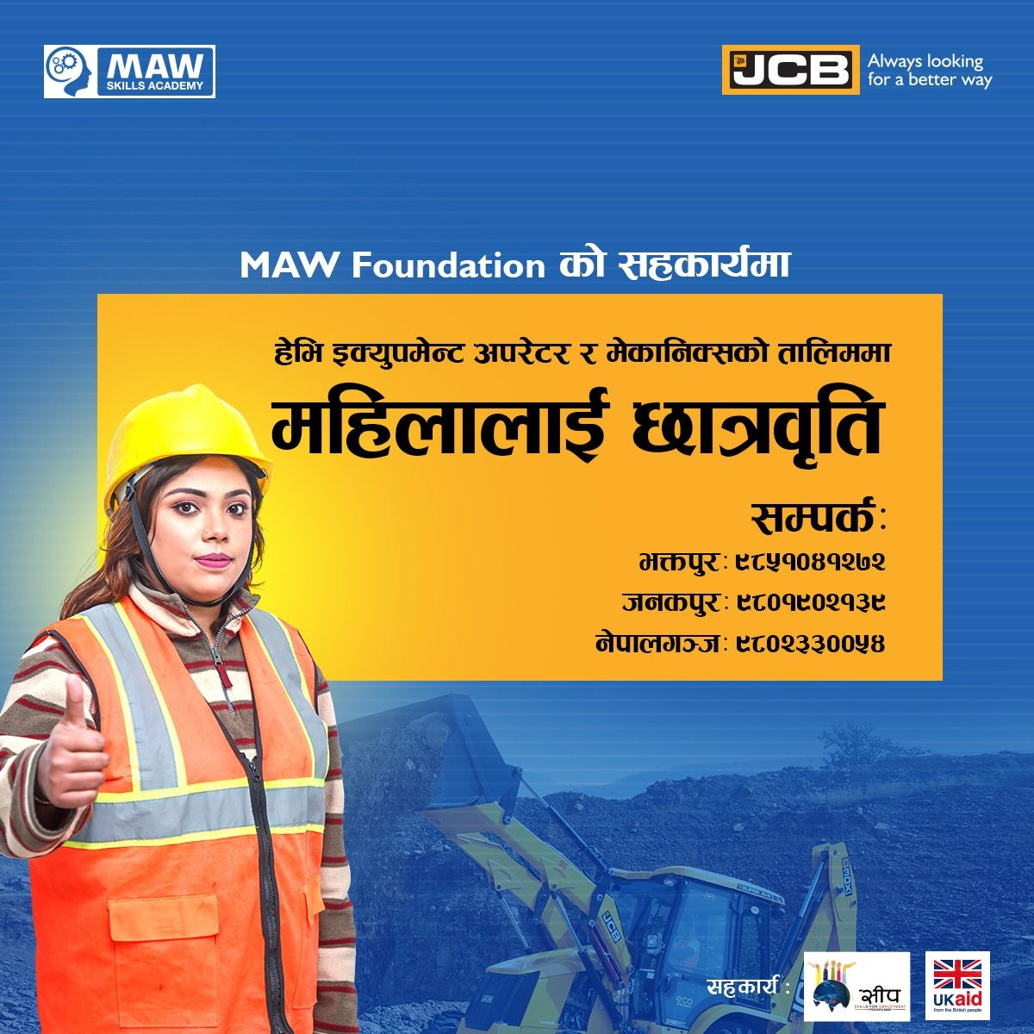
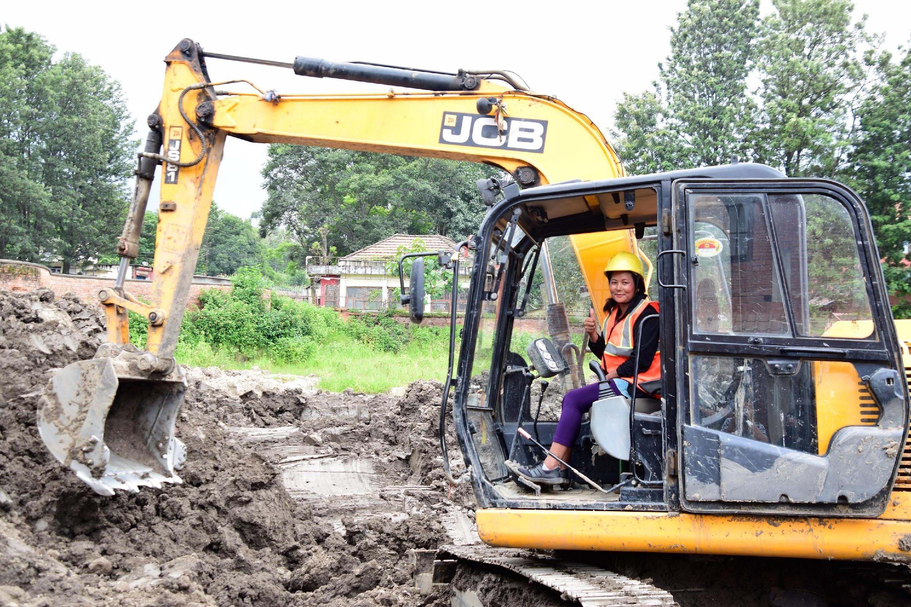
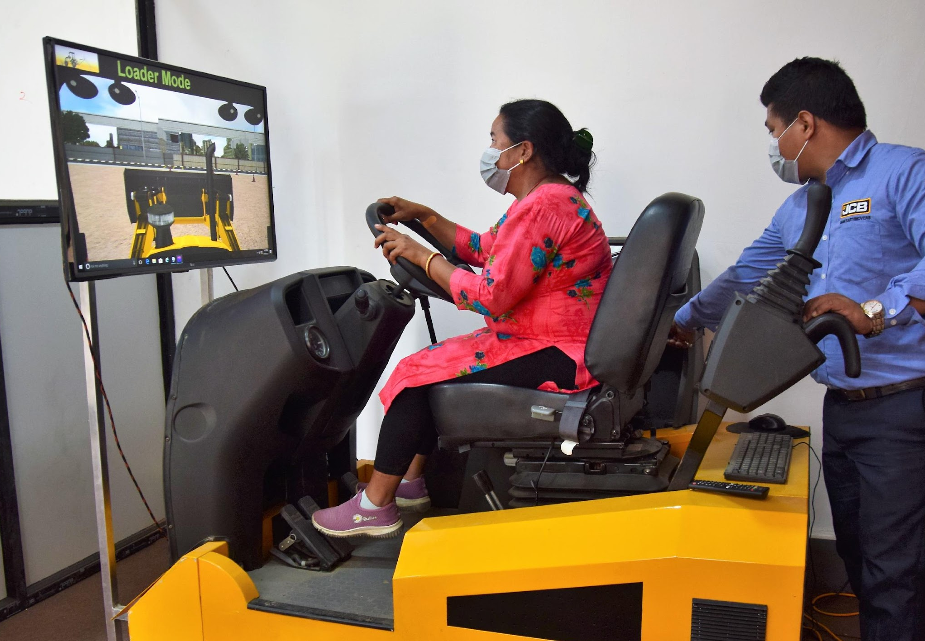
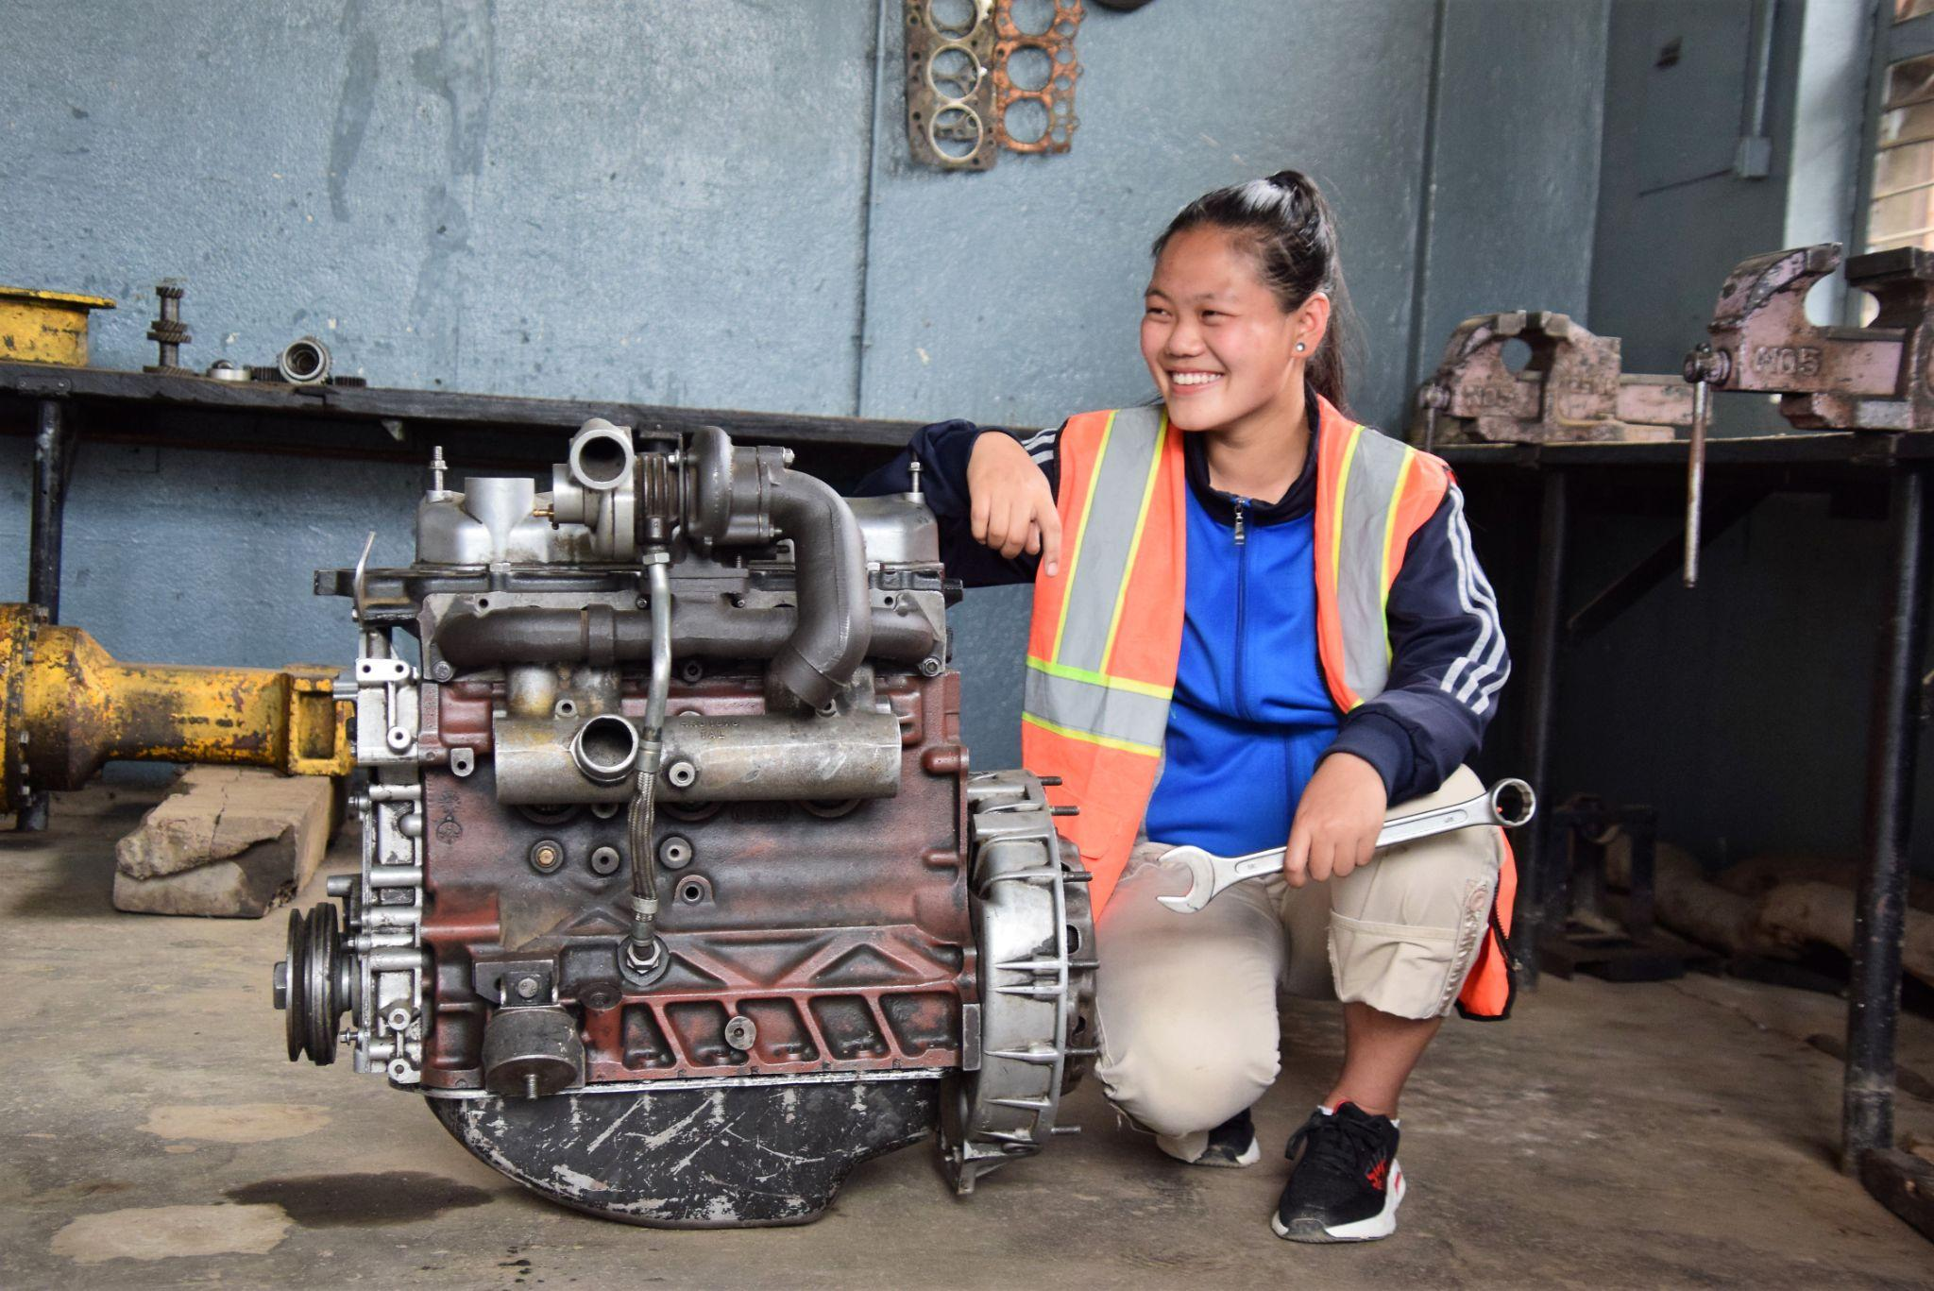
GESI Mainstreaming: Morang Earth Movers (MEPL), Construction Sector
 | INTERVENTIONS
Constraints | Assets, Service, Opportunity | Voice and Agency | Enabling Environment: Formal & Information Institutions
Inequitable Geographic Access Financial gap Information Asymmetry Gender Stereotypes Lack of Sensitivity from training providers/instructors Absence of supportive services | Training infrastructure expanded in Nepalgunj & Janakpur to improve access for women & DAGs Scholarship Fund launched by MEPL’s Foundation Co-funding leveraged from 11 Municipalities and 14 CBOs/NGOs GESI-intentional marketing materials Accommodation provision for women (relocation challenge) Extensive outreach: social media, local GoN, NGOs, community mobilization | Enabling more women (graduates) as operators and trainers: promoting role models. Training Instructor sensitized on GESI and Safeguarding. Safeguarding and Inclusion messages integrated in skilling curricula. | Targeted outreach to build greater awareness, interest, and referral linkages via local organizations-to change norms about suitability and desirability of work. e.g. USAID’s Hamro Samman project, Maiti Nepal) More women recruited in team and as instructors.

Slide 6
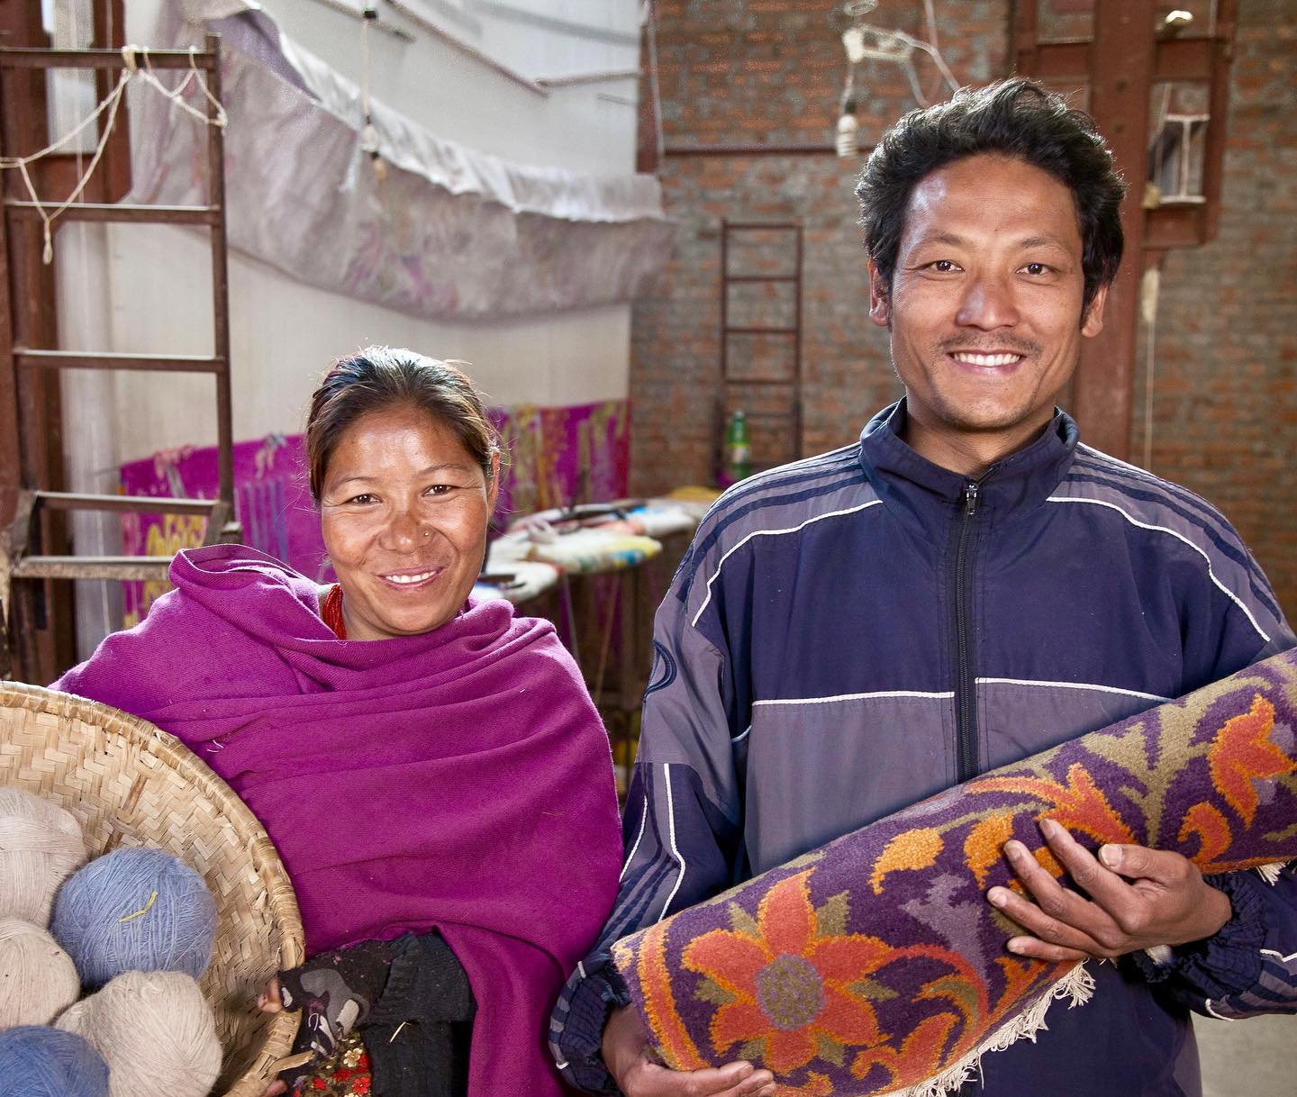
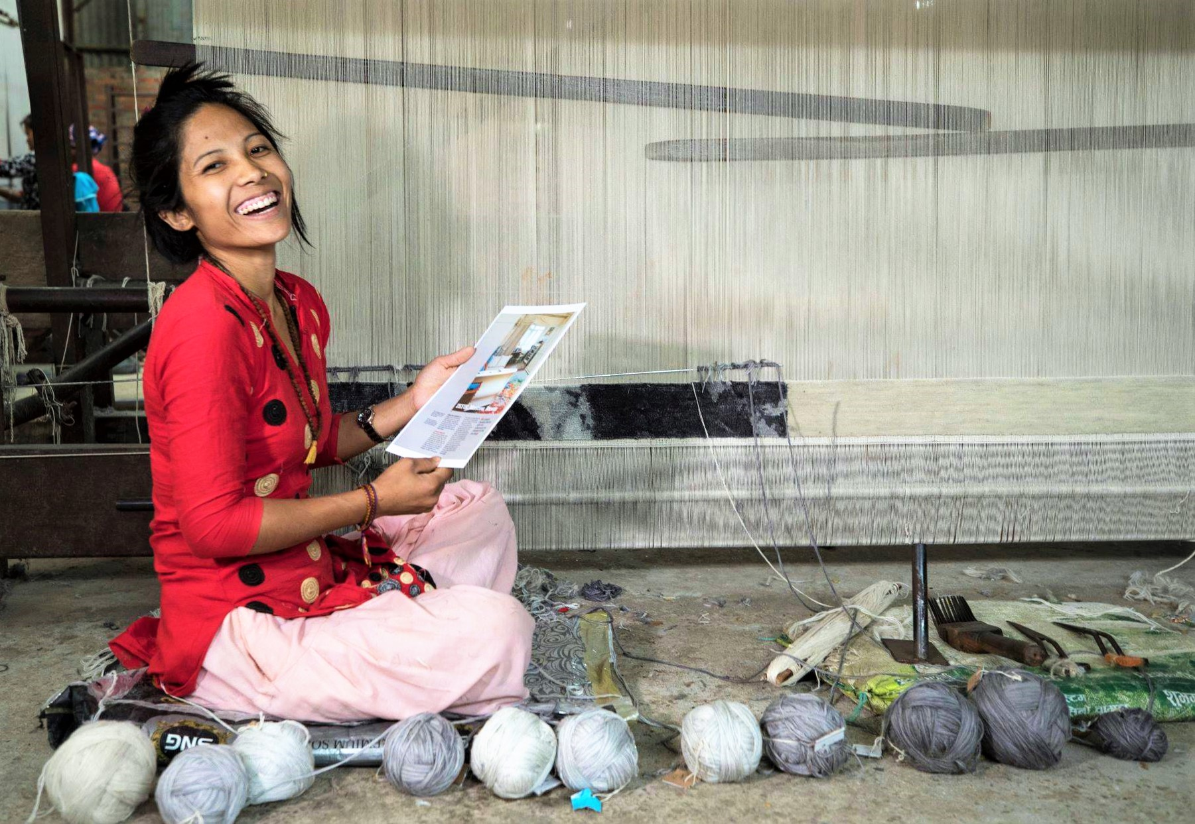
GESI Integration: Label STEP, Manufacturing Sector (Carpet)
 | INTERVENTIONS
Constraints | Assets, Service, Opportunity | Voice and Agency | Enabling Environment: Formal & Information Institutions
Inequitable geographic access Information asymmetry Lack of sensitivity from training providers/instructors Absence of supportive services Lack of perceived dignity of labour. Financial gap. | Decentralized weaving workshops to Province 2, Sarlahi - “access at doorstep” International-quality competency standard, industry-led skilling and certification introduced to build qualified and committed weavers. Increased engagement of women in graphical design, leadership roles, including as instructors. Linkage with Banks (Prabhu Bank) to enable productive utilization of remittance for locally-based weaving workshops set-up. | Promotion of weaving as a dignified and artistic role. Integration of financial and business literacy to build economic understanding. | Introduction to concept of Artisan Village, brining carpet industry to home of the weavers. Integration of GESI and safeguarding measures, coupled with visits from international designers, has ensured decent and dignified work and is changing and shaping weaver’s notion of weaving as high valued work

Slide 7

GESI Mainstreaming: Shreenagar Agro Farm & Kheti, Agriculture Sector
 | INTERVENTIONS
Constraints | Assets, Service, Opportunity | Voice and Agency | Enabling Environment: Formal & Information Institutions
Inequitable geographical access Financial gap Skilling gap Lack of gender friendly agri-technology (increased drudgery); lack of harvesting solutions Absence of linkage to market Lack of transportation | State-of-the-art skilling facility and lab constructed in Province 5. Access to gender friendly technologies Farmer-oriented practical skilling Improved market linkages End-to-end solutions for farmers and small agri-enterprises, connecting farmers directly with consumers. Skilling targeted towards PWDs | Integration of soft skills during. | Linking supply-demand side through empowering more farmers to use digital technologies. Introduction of e-learning platforms to enhance access of returnee migrants & migrants based in India, Malaysia and Saudi Arabia. Boarding facilities for farm employees to restrict movement (in light of pandemic).

Slide 8

GESI Mainstreaming: Upaya City Cargo, Cross-Cutting
 | INTERVENTIONS
Constraints | Assets, Service, Opportunity | Voice and Agency | Enabling Environment: Formal & Information Institutions
Financial gap Information Asymmetry Gender Stereotypes Absence of supportive services | Expanded infrastructure to underserved regions: Butwal, Bhairawa, and Pokhara (address inequitable access gaps) Flexible, higher pay for women. Use of GESI-intentional communications and marketing approach and materials. Financing arrangement from Kumari Bank to acquire 2 and 4-wheelers (asset acquisition) | Promoting role models: increased visibility of women drivers. Team sensitized on GESI and Safeguarding. Safeguarding and Inclusion messages integrated in skilling curricula. | Stronger livelihood ecosystem built for women and DAGs via collaborative partnerships with vehicle dealers (Sipradi & Thee Go), bank (Kumari), and trainers. Safeguarding/helpline button in app for emergencies to prioritise the safety of driver/rider partners. Referral linkages established via targeted outreach and mobilizing of local NGOs and local transportation hubs to build greater awareness and interest (change norms about suitability and desirability of work). More women recruited in team and as instructors. Extensive, targeted outreach: social media, local GoN, NGOs, community mobilization (information asymmetry)

Slide 9
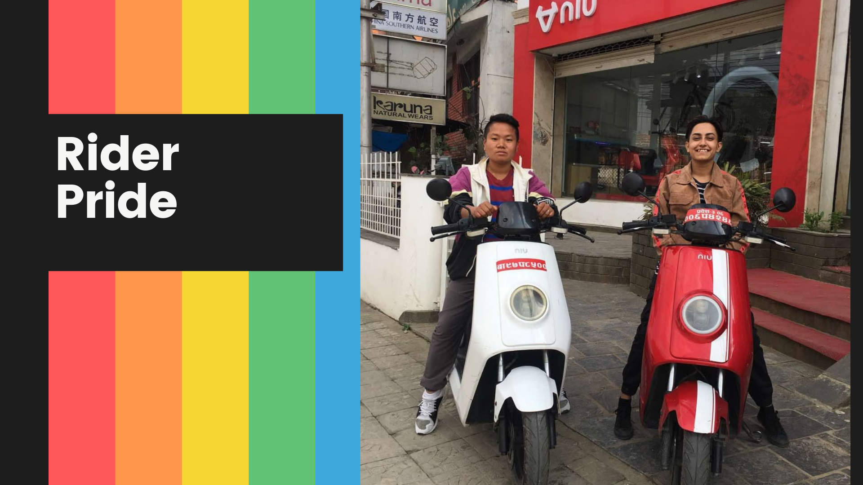
GESI Good Practices/Lessons
Start with analysis– expand understanding of GESI gaps/barriers and opportunities
Gravitate towards partners who demonstrate strong GESI potential-cemented by making inclusion a key investment criteria
Co-create GESI-intentional intervention with the partner–helps deepen GESI understanding and strengthen GESI approach and plans
Set aside dedicated resources (budget/staff) for GESI-vital to maintain adequate attention
Ensure sustained and context-responsive TA on GESI – from training, mentoring, to monitoring
Facilitate industry linkages to local NGOs, Government ESCs, and community networks- will enable increased mobilization of women and DAG groups
Integrate GESI as part of business operation/value chain-so it’s not just project-limited, and ad-hoc
Deliberate GESI focus via Monitoring, Evaluation, and Reporting
Cultivate Inclusion Champions and Role Models -who also ‘get it’ and advocate for it
Sociocultural barrier & entry on GESI for the 1st time for industries - longer time and effort required to create inclusion
GESI-based Adaptive Management and Scale-up- scale-up partnership based on GESI achievements, evidence, and learning
Practice what you preach-ensure inclusive, empowering, safe work environment starts at home

Slide 10
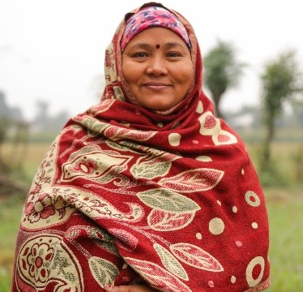
FOR ADDITIONAL INFORMATION
Stay Connected!
Website: www.seepnepal.com
LinkedIn: Linkedin.com/company/ukaid-skillsforemployment
Facebook: @SkillsforEmploymentProgrammeNepal
Twitter: @SEEP_Programme
Baljit Vohra
Team Leader
baljit.vohra@seepnepal.com
Stuti Basnyet
Deputy Team Leader
Director – Strategic Partnerships and Innovations
stuti.basnyet@seepnepal.com
Archana Gurung
Director – Inclusion & Communications
archana.gurung@seepnepal.com

