Slide 1
UKaid
Skills for Employment Programme (सीप)
Safeguarding Orientation Pack to UKaid सीप partners

Slide 2
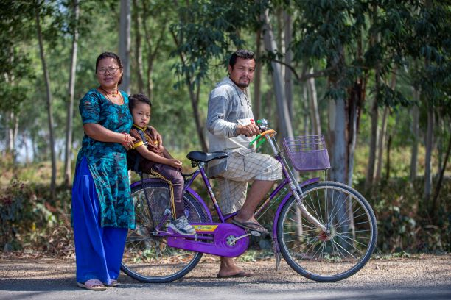
Safeguarding Against
Sexual Exploitation,
Abuse & Harassment
of}ghGo zf]if0f
tyf b'/frf/af6 ;'/Iff

Slide 3
Define
“Children”
“ बाल बालिका ” sf] kl/efiff

Slide 4
CHILDREN / बाल बालिका
Children are defined by the UN Convention of the Rights of a Child as being someone under the age of “18” years, regardless of the local age of majority/consent.
:yfgLo d'n'ssf] kl/efiffdf h];'s} elgPtf klg ;+o'Qm /fi6«;+3sf] kl/efiff cg';f/, afnaflnsf eGgfn] !* jif{eGbf sd pd]/sfnfO{ a'lemG5.

Slide 5
Define
“ADULTS-AT-RISK”
“hf]lvddf /x]sf jo:sx¿” sf] kl/efiff

Slide 6
ADULTS/PEOPLE-AT-RISK / hf]lvddf /x]sf jo:sx¿
Those aged over 18 years who are unable to take care of themselves / protect themselves from harm or exploitation
OR
Who, due to their gender, mental or physical health, disability, ethnicity, religious identity, sexual orientation, economic or social status, or as a result of disasters and conflicts, are deemed to be at risk.
!* jif{eGbf dflysf] pd]/ ePtf klg cfˆgf] x]/rfx cfkm}F ug{ g;Sg] / cfkm" dfly x'g] xfgL jf zf]if0faf6 ;'/Iff ug{ g;Sg] JolQm,
jf
n}lª\us, dfgl;s jf zf/Ll/s :jf:Yo, ckfª\utf, hftLotf, wfld{s klxrfg, of}lgs klxrfg, cfly{s jf ;fdflhs :t/ jf k|fs[lts k|sf]k / åGådf k/]sf sf/0f hf] hf]lvddf kg{;Sg] b]lvG5g\ .

Slide 7
Do you work with people-at-risk?
s] tkfO{+ hf]lvddf /x]sf jo:sx¿;+u÷sf nflu
sfd ug{"x'G5<

Slide 8
Let’s explore more
What makes people-at-risk more vulnerable to Sexual Exploitation, Abuse & Harassment (SEAH)?

Slide 9
But we need to understand some fundamental terminologies before.

Slide 10
WORKPLACE (WORLD OF WORK) / कार्यस्थल
“Formal”:
    Four walls of an office, training centre, factory, E-mail, etc.
“Informal” spaces:
    Open spaces: Construction sites, farms-site, digital, space reach via phone/message etc.
    Closed spaces: domestic workers
æcf}krfl/sÆM
    sfof{:yn, cf}krf/Ls ?kdf ul/g] Od]n, cflb
æcgf}krfl/sÆ :yfgM
    v'nf :yfgM निर्माणछेत्र, s[lif kmfd{, df]afO{, Og6/g]6sf] bfo/fdf, cflb
    aGb :yfgM 3/fozL dhb'/

Slide 11
HARASSMENT / उत्पीडन
pTkL8g eg]sf] jf:tljs jf wDsLk"0f{ k|s[ltsf] sfo{ jf cfzlQm xf] h'g kL8fo'Qm, nHhfhgs, eoo'Qm / clk|o x'G5 . To:tf] Jojxf/df h;n] JolQmnfO{ eoo'Qm, clk|o jf k|lts"n jftfj/0f l;h{gf ub{5 .
  Harassment is any form of behavior that is unwelcome, unsolicited, unreciprocated and usually (but not always) repeated.
  It is likely to offend, humiliate or intimidate.

Slide 12
SEXUAL HARASSMENT / यौनजन्य उत्पीडन
  Any sexual behaviour that is unwelcome, inappropriate and offensive to the recipient and creates a hostile, humiliating, and intimidating environment.
  It is the behavior that fails to respect the dignity of people within and outside the workplace.
s'g} klg clglR5t, cg'lrt of}ghGo dfu, rfxgf h'g df}lvs, ;f+s]lts tyf zfl//Ls ?kdf x'g] of}ghGo k|s[ltsf] Jojxf/sf] ?kdf JoQm x'G5 .
s;}sf] ;Ddfgdf cf3ft kfg]{ of}ghGo Jojxf/ jf of}gdf cfwfl/t cGo Jojxf/, h'g To:tf] Jojxf/df kg]{ JolQmsf nflu cg'lrt / kL8fbfoL x'G5 .

Slide 13
TYPES OF SEXUAL HARASSMENT / यौनजन्य उत्पीडनका प्रकार
Quid pro quo (“this for that”)
    Seeking sexual favours or advances in exchange for work benefits. Consent to sexually explicit behaviour or speech for employment
æo;sf] nflu Tof]Æ
cfsif{s tna, ;]jf ;'ljwf, kbf]GgtL, hfuL/sf] lg/Gt/tf clbsf] abnfdf of}ghGo ;xof]u jf nfe vf]Hg' .

Slide 14
TYPES OF SEXUAL HARASSMENT / यौनजन्य b'/frf/का प्रकार
    Hostile work environment
    More pervasive and insidious form that makes the work environment intimidating and threatening for employees, labourers, workers.
sfo{:yndf k|lts"n jftfj/0f
sfdsf] abnfdf of}g cfzlQmsf] Jojxf/ h;n] sd{rf/L tyf sfdbf/nfO{ sfo{:yndf a:g c;Xo agfpFb5 .

Slide 15
SEXUAL HARASSMENT COULD BE / यौनजन्य b'/frf/का अरु प्रकार
    Verbal
    df}lvs
    Non-verbal
    O;f/f -xfpefp_
    Physical
    zf/Ll/s
    Graphic or Electronic
    lnlvt / clZnntf k|bz{g

Slide 16
IMPORTANT TO UNDERSTAND/ बुझ्नु clt आवश्यक
IMPACT -k|efj_ on the person being harassed -lkl8t_
NOT
INTENTION -cfzo_ of the harasser -lk8s_

Slide 17
Turning over to you
What is SEAH?
of}ghGo zf]if0f tyf b'/frf/ eGgfn] s] a'lemG5 ?

Slide 18
SEXUAL EXPLOITATION / यौनजन्य शोषण
Any actual or attempted abuse of a position of vulnerability, differential power, or trust, for sexual purposes, including but not limited to, showing monetary, social or political gain from the sexual exploitation of another.
of}g zf]if0f eg]sf] s'g} klg afnafnLsf jf joZs, To;df klg cem hf]lvddf /x]sf joZs -cem dlxnf al9 hf]lvddf /xg] xFbf_, sf] cj:yfsf] kmfO{bf p7fO of}ghGo b'Jo{jxf/ tyf b'/frf/ ug]{, km/s Ifdtfsf] jf zlQm jf ansf] k|of]u ul/ of}g clek|fosf] nflu ul/g] sfo{ — cfly{s, ;fdflhs tyf /fhg}lts nfe b]vfO{ c? dfly ul/g] of}ghGo b'Jo{jxf/ .

Slide 19
SEXUAL ABUSE / यौनजन्य दुराचार
The actual act/threat of physical intrusion of a sexual nature, whether by force or under unequal or coercive conditions.
of}g b'/frf/ eGgfn] anhk\m\tL jf c;dfg cj:yf jf ljjz agfP/ of}gsf] cfzon] zf/Ll/s ¿kdf hf]/hah{:tL ug'{, ug]{ k|of; ug'{ jf wDSofpg"nfO{ a'emfpFb5 .

Slide 20
Harm/ xfgL
Harm
Psychological, physical and any other infringement of an individual’s rights.
Psychological harm
Emotional or psychological abuse, including (but not limited to) humiliating and degrading treatment such as bad name calling, constant criticism, belittling, persistent shaming, solitary confinement and isolation
xfgL Pp6f JolQmsf] zf/Ll/s, dgf]j}1flgs cyjf ;f] JolQmsf] s'g} klg k|sf/sf] clwsf/sf] xgg\ jf pNnª\3g eGg] a'em\g'kb{5 .
dgf]j}1flgs xfgL ckdfghgs efiffsf] k|of]u, lgoldt cfnf]rgf, xf]Rofpg] tyf nlHht kfg]{ k|j[ltsf l6Kk0fL, PSn\ofpg] tyf lxF88'ndf cj/f]w ug{] vfnsf efjgfTds tyf dgf]j}1flgs xfgL eGg] a'em\g'kb{5 .

Slide 21
Turning over to you
What is Safeguarding Against SEAH?
of}ghGo zf]if0f tyf b'/frf/af6 ;'/Iff eGgfn] s] a'lemG5 ?

Slide 22
Safeguarding broadly means abiding by the principle of “Do-No-Harm”/Zero Tolerance Against Harm
xfgL lj?¢ æzGo zxlG;ntfÆ

Slide 23
Safeguarding against SEAH is part of सीप’s Gender and Social Inclusion (GESI) intervention targeting women, Disadvantaged Groups (DAGs), and People with Disabilities (PwDs).
WSP, together with our consortium partners and Challenge Fund partners (such as yourselves), aims to understand the transformational challenges that firms and Nepalis face and jointly explore how GESI and Safeguarding integration can contribute to addressing those challenges.

Slide 24
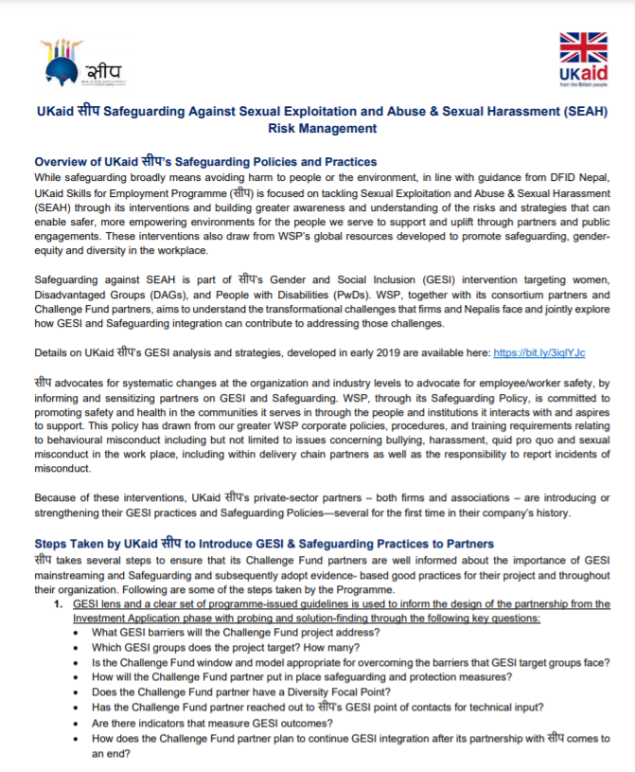
UKaid सीप’s SAFEGUARDING POLICY/यौनजन्य उत्पीडन शोषण तथा दुराचारबाट सुरक्षा नीति
This policy/guideline applies to all Employees, Consultants, Partners and others acting on behalf of, or with UKaid सीप
o; gLlt/÷lgb]{lzsfn] UKaid सीप sf ;a} txdf sfo{/t JolQmx¿ cyf{t\ sd{rf/L, k/fdz{bftf, tyf kf6{g/ tyf kf6{g/sf sd{rf/L jf xfd|f] tkm{ jf xfdL;+u sfd ug]{]{ s'g} klg JolQmx¿nfO{ ;d]6\b5 .

Slide 25
Safeguarding Risks and Mitigation Strategy and Plans
Risk
Mitigation Strategy & Plans
Partners who have not been sufficiently vetted or trained in safeguarding against SEAH may pose a risk to vulnerable people, or fail to support them to seek help
Partners who have not been sufficiently vetted or trained in safeguarding against SEAH may pose a risk to vulnerable people, or fail to support them to seek help
Partners who have not been sufficiently vetted or trained in safeguarding against SEAH may pose a risk to vulnerable people, or fail to support them to seek help
In lack of training on safeguarding against SEAH, may pose a risk to vulnerable people, or fail to support them to seek help
Regular and systematic safeguarding sessions with all partners and SEP (e.g. Monthly Partner Meetings; Quarterly Strategic Review; and Peer-to-Peer Learning)
Share and promote guidance for Safeguarding against SEAH
GESI and Safeguarding integrated in reporting procedures (e.g. monthly reports and quarterly reports from partners)
Review GESI and Safeguarding as part of due diligence of prospective partners
Share and promote guidance for Safeguarding against SEAH
Orientation and training to partners and development of partner- specific GESI and Safeguarding policies/code of conduct
Orientation and training to partners and development of partner- specific GESI and Safeguarding policies/code of conduct
Orientation and training and development of partner-specific GESI and Safeguarding policies/code of conduct

Slide 26
Safeguarding Risks and Mitigation Strategy and Plans
Risk
Mitigation Strategy & Plans
Women are likely to be at an increased risk of experiencing SEAH at workplaces where male workers are in high demand. & number. This also results in challenges to reporting in male dominated workforces, with inadequate safeguards against SEAH
Prioritise engaging with, and informing male leaders, trainers, and all trainees on SEAH and reporting mechanism.
Check regularly that SEAH safeguarding measures are being adhered to.
UKaid सीप’s anonymous hotline has been shared with all partners—who are encouraged to disseminate it for awareness and access by staff, trainees, and workers at all levels.

Slide 27
Safeguarding Risks and Mitigation Strategy and Plans
Risk
Mitigation Strategy & Plans
Marginalised groups and PwDs are at higher risk of experiencing SEAH due to widespread discrimination against them
We encourage you to conduct awareness raising activities targeted at PwDs, on how to report SEAH.
Integration of GESI and Safeguarding is encouraged in skilling curriculums/manuals.

Slide 28
Safeguarding Risks and Mitigation Strategy and Plans
Risk
Mitigation Strategy & Plans
Risk
Migrant workers returning during COVID-19 are vulnerable to SEAH
Ensure that you are working to onboard returnee migrants in their workspaces/factories are fully aware of exploitation risks faced by these groups and have a strategy to create a safe working environment for them.
Encourage you to disseminate messages which dispels myths and rumours about returnees in connection with Covid-19

Slide 29
Safeguarding Risks and Mitigation Strategy and Plans
Risk
Mitigation Strategy & Plans
Economic pressure brought about by Covid-19 might compel children, who are not in school, to work in construction sites or factories.
Be clear that UKaid and सीप has zero-tolerance to child labour, or SEAH of children
Ensure that SEAH messaging targets children and families who are most vulnerable

Slide 30
Safeguarding Risks and Mitigation Strategy and Plans
Risk
Mitigation Strategy & Plan
Partners capacity to reach and support beneficiaries during Covid-19 has decreased. This might result in fear to report any cases of SEAH due to misconceptions that support might be limited or unavailable
Ensure that whistle-blowers and victims of SEAH receive support despite any reductions in capacity; UKaid सीप’s anonymous hotline has been shared and reinforced regularly.

Slide 31
Safeguarding Risks on Women and Covid-19
Increased stigma and discrimination linked to race and gender
Immediate needs of women on the frontlines overlooked, including menstrual hygiene supplies
Serious threat to women’s economic empowerment and livelihoods, especially in the informal sector
Unpredictable and severe travel bans impact on women migrant workers
Increased risks of GBV and disruption of mechanisms for GBV prevention and response
Exacerbated burdens of unpaid care work on women

Slide 32
Turning over to you
Why is Safeguarding Against SEAH Important?
of}ghGo zf]if0f tyf b'/frf/af6 ;'/Iff lsg cfjZos 5?

Slide 33
Core Principles
Sexual exploitation and abuse are acts of gross misconduct and represent grounds for disciplinary and more serious actions.
Sexual activity with children is prohibited regardless of the local age of consent or local/national laws; ignorance or mistaken belief in the age of the child is not a defence.
UKaid सीपsf sd{rf/L / ;Da4 clwsf/L tyf kf6{g/ ;+:yfx¿af6 x'g] of}g zf]if0f tyf b'/frf/nfO{ cToGt unt cfr/0fsf ¿kdf lnOg] 5 .
:yfgLo txdf ax'dtn] :jLsf/]sf] pd]/ jf ;xdltsf nflu tf]lsPsf] pd]/sf] ;Ldf h];'s} ePtf klg !* jif{eGbf sd pd]/sf afnaflnsf;Fusf] of}g lqmofsnfknfO{ lgif]w ul/Psf] 5 .

Slide 34
Core Principles
of}g sfo{ nufot of}ghGo lqmofsnfkdf ;dy{g hgfpg] k|j[lQ jf cGo s'g} klg lsl;dsf ckdfghgs Jojxf/ jf zf]if0fsf nflu ul/g] k};f, /f]huf/L, ;fdfg jf ;]jfsf] ;f}bfafhLdf /f]s nufOPsf] 5 . o; cGtu{t sfo{qmdsf ;xefuLx¿;Fu ul/g] s'g}klg lsl;dsf] ;xof]u cfbfg–k|bfg ;d]t kb{5g\ .
Exchange of money, employment, goods or services for sex, including sexual favours or other forms of humiliating, degrading or exploitative behaviour is prohibited. This includes the exchange of assistance that is due to beneficiaries

Slide 35
Core Principles
kbLo cfwf/df km/s x}l;ot ePsf sd{rf/L tyf / sfo{qmdsf ;xefuLx¿;Fu ul/g] of}g ;DaGwnfO{ klg s8fOsf ;fy lg?T;flxt ul/Psf] 5 . o:tf ;DaGwn] UKaid सीपn] ug]{ ljsf;sf sfdsf] ljZj;lgotf / OdfGbf/LnfO{ g} sdhf]/ agfpg] 5 .
Sexual relationships between beneficiaries and anyone acting on behalf of UKaid सीप are strongly discouraged since they are based on inherently unequal power dynamics.
Such relationships undermine the credibility and integrity of UKaid सीप.

Slide 36

Core Principles
When there is a concern or suspicions regarding sexual exploitation or abuse, they must be reported via established reporting procedures.
of}g zf]if0f tyf b'/frf/sf af/]df rf;f] jf zª\sf pTkGg ePdf ;+:yfsf] :yflkt ;+oGqdfkm{t\ To; ljifodf tTsfn va/ ug'{ kg]{5 .

Slide 37
Core Principles
Every individual need to create and maintain an environment that prevents sexual exploitation and abuse. Partner Managers at all levels have particular responsibilities to support and develop systems that maintain this environment.
of}g zf]if0f tyf b'/frf/ /f]Sg] jftfj/0f agfpg] bfloTj xfdL ;a}sf] xf] / o;sf] sfof{GjognfO{ k|j4{g xfdL ;an] ug'{ kb{5 .

Slide 38
CORE PRINCIPLES / d"n l;4fGtx¿
It is the duty of all employees, and partners to Prevent and Respond to SEA.
of}g zf]if0f tyf b'/frf/ /f]Sg' / o; ;DaGwL lhDd]jf/L jxg ug'{
;a} sd{rf/L tyf ;fem]bf/sf] bfloTj xf] .

Slide 39
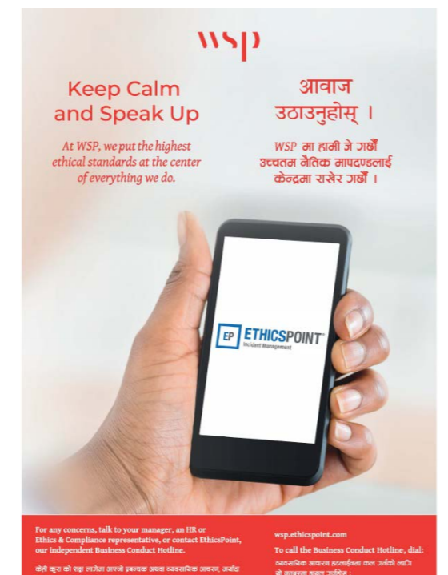
REPORTING / ph'/L
To tackle power imbalances, particularly gender inequality; taking a survivor-centred approach; we encourage reporting while doing no harm.
Whistle-blower Website: wsp.ethicspoint.com
Dedicated Number to call from Nepal: 00-1-887-315-9932
Provided by an independent third-party provider
Toll-free call center and web intake site
Confidential, anonymous if desired
Anti-retaliation policy for those who report concerns in good faith (zero reprisals)

Slide 40
LEGAL PROVISONS / कानूनी प्रावधान
संविधान (38-3)
श्रम कानुन २०७४
सर्वोच्च अदालतको निर्णय
कार्यस्थलमा हुने यौनजन्य दुर्व्यवहार निवारण ऐन २०१५
मुलुकी अपराध संहिता ऐन २०७४

Slide 41
We do not have all the answers. We need your help in ensuring we do no harm. So, time to get your views on these questions:
i) Major safeguarding issues
ii) Barriers to effective safeguarding
iii) How to make it safe to report and take action?
iv) What are some of the good practices?

Slide 42
Time for simulation
Scenario
Kalpana Pariyar (mock identity), 32, works at the factory, that you manage. Her husband lost job owing to the economic pressure brought about by the Covid-19 pandemic at his workplace. Kalpana is now the only bread-winner for the family of four (including two children). But the factory she works in, is downsizing too, due to pandemic’s led economic impact.
Kalpana’s supervisor has assured she won’t have to lose her job. But he needs a favor in return, which is of sexual nature.
Kalpana talked to her co-worker informally, about the proposal, and somehow the message came to you. What will be your immediate move/response? What will be your longer-term strategy to mitigate these risks of these nature?

Slide 43
PREVENT it from happening
LISTEN to those who are affected
RESPOND, sensitively and with confidentiality, but robustly
LEARN from every case

Slide 44
Thank you

Slide 45
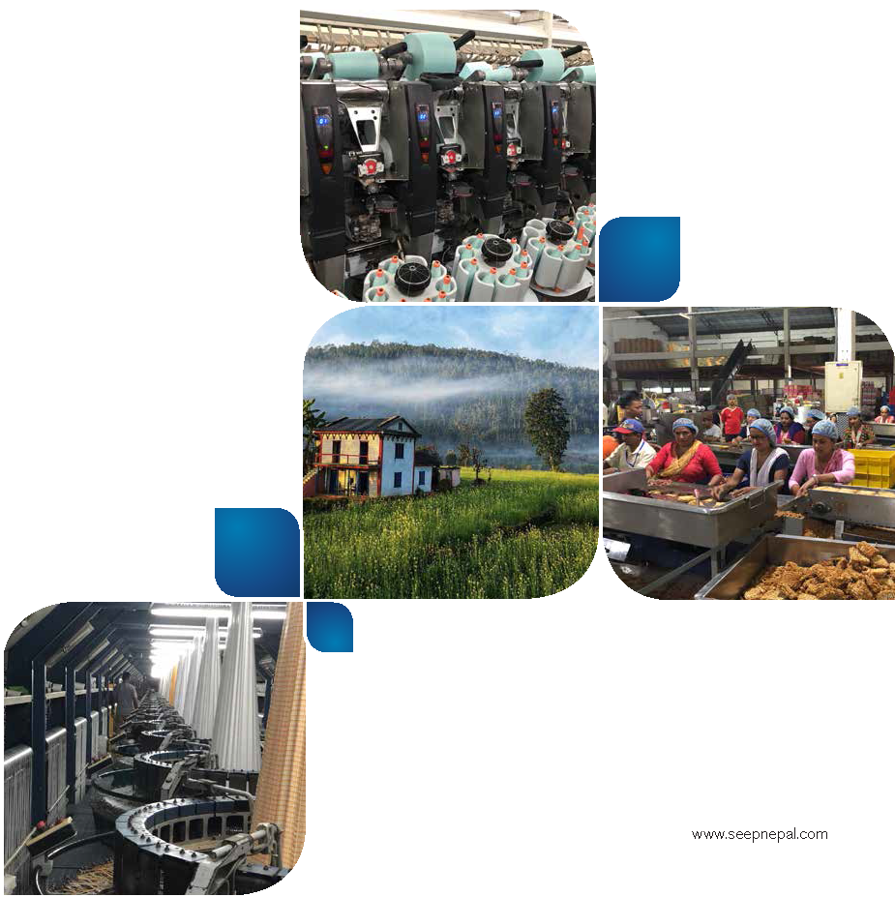
FOR ADDITIONAL INFORMATION
Archana Gurung
Director – Strategic Communications, Learning and Inclusion
Email: archana.gurung@seepnepal.com

